Slide 1
Adv. Biopharmaceutics
Dr. Mohammed Sabbar
College Of Pharmacy - Basrah
3rd Oct. 2018
http://bit.do/ex2aD

Slide 2
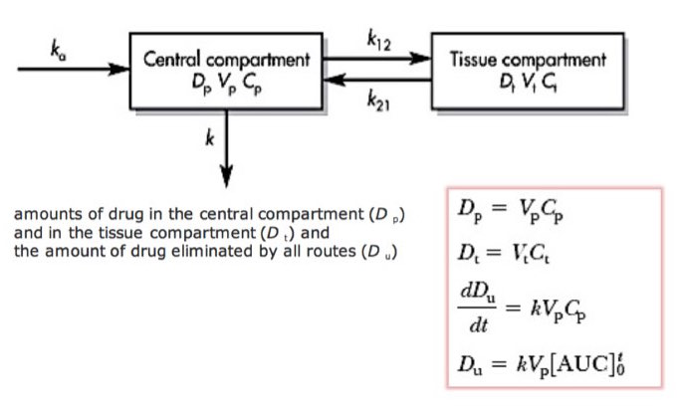
DETERMINATION OF K_{A} FROM TWO-COMPARTMENT ORAL ABSORPTION DATA
(LOO-RIEGELMAN METHOD)

Slide 3
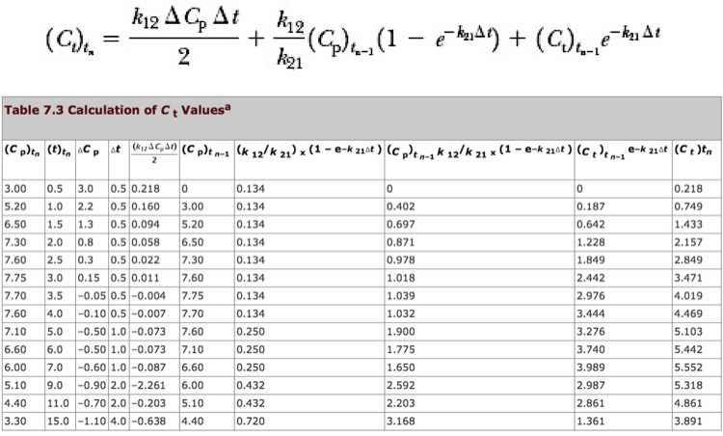

Slide 4
For calculation of the k _{a} by this method, the drug must be given intravenously to allow evaluation of the distribution and elimination rate constants.
For drugs that cannot be given by the IV route, the k _{a} cannot be calculated by the Loo–Riegelman method. For these drugs, given by the oral route only, the Wagner–Nelson method, which assumes a one-compartment model, may be used to provide an initial estimate of k _{a}.
If the drug is given intravenously, there is no way of knowing whether there is any variation in the values for the elimination rate constant k and the distributive rate constants k ₁₂ and k ₂₁. Such variations alter the rate constants. Therefore, a one-compartment model is frequently used to fit the plasma curves after an oral or intramuscular dose. The plasma level predicted from the k _{a} obtained by this method does deviate from the actual plasma level. However, in many instances, this deviation is not significant.

Slide 5
FREQUENTLY ASKED QUESTIONS
1. What is the absorption half-life of a drug and how is it determined?
2. When one simulates drug absorption with the oral one-compartment model, would a greater absorption rate constant result in a greater amount of drug absorbed?
3. How do you explain that k _{a} is often greater than k with most drugs?
4. Drug clearance is dependent on dose and area under the time–drug concentration curve. Would drug clearance be affected by the rate of absorption?
5. In switching a drug from IV to oral dosing, what is the most important consideration?
Problems practice Ch 7
PHARMACOKINETICS OF DRUG ABSORPTION

Slide 6
Why is the bioavailability of Erythromycin highly variable ?

Slide 7
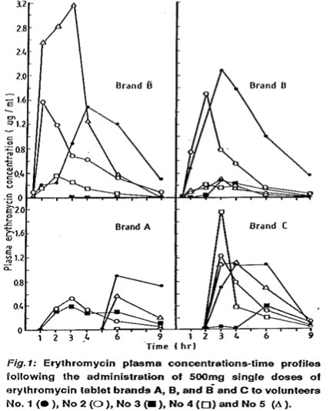

Slide 8
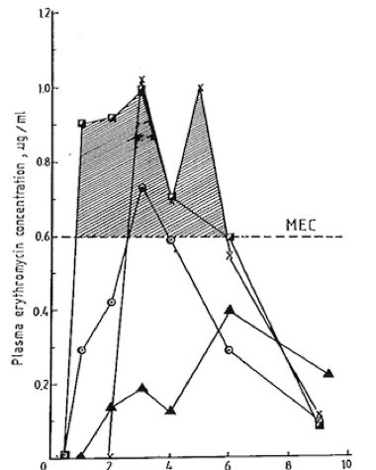

Slide 9
Biovailability and stability of erythromycin delayed release tablets
When administered to four healthy subjects, the product
gave a relative biovailability of 105.31% which conforms
to USP standards.

Slide 10
Erythromycin Base, Stearate and Estolate absorption
The pharmacokinetics of erythromycin and erythromycin 2’-propanoate were studied in healthy male volunteers following single and repeated doses of erythromycin stearate tablets, erythromycin estolate capsules, and a suspension.
Estolate dosages gave rise to higher plasma levels of total drug than the stearate.
However, the stearate yielded higher plasma levels of erythromycin base.
Absorption of all dosage forms, except the suspension, was delayed,
Pharmacokinetic interpretation of both single - and multiple-dose data required incorporation of an absorption lag time.
The absorption of erythromycin stearate was inhibited by food and also by low fluid volumes in fasted subjects.
Absorption of erythromycin estolate was increased in the presence of food and was not greatly affected by fluid volume.
Although single-dose data poorly predicted circulating levels of erythromycin following repeated doses, trends observed after single doses were maintained during chronic treatment.

Slide 11
Thank you

